Slide 1


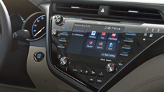





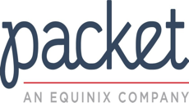



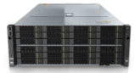


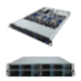
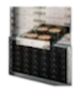





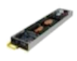

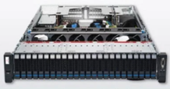
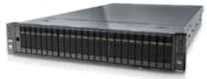
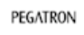





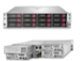



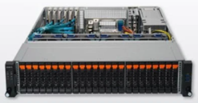


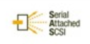





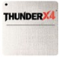
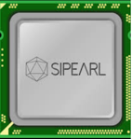
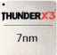
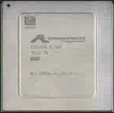
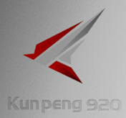
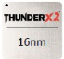
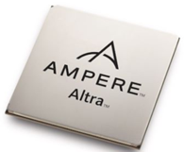
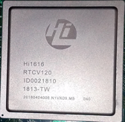
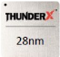
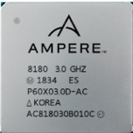
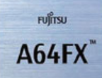
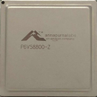
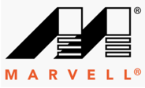



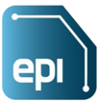

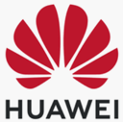


ARM64 Booming: One Architecture, Many SoC CPUs & Servers
One Architecture & Many SoCs, Servers and Cloud Instances from several Cloud, OEM/ODM & SoC Providers
Apps
Cloud-Native
HPC
Big Data
Automotive Computing
Cybersecurity
Cloud Instance
Kc1.xxxx.y
www.worksonarm.com
EC2 M6g, C6g, R6g
Huawei Cloud
1U, 2U,2U4
1U, 2U,2U4, OCP
1U, 2U
TaiShan 5280
ARM64 Servers
TaiShan 2280
TaiShan 6000
Storage I/F:
Storage RAID:
10/25/ 100GE RNIC:
56/100/200G IB HCA:
I/O
Hi1630
“
Graviton2
Cronos
Hi1620
KunPeng 930
Siryn
2022
Mystique
2022
NG
Rhea
Hi1616
2021
2020
2021
Graviton
2019
2022-2023
ARM64 SoC
2019
2018
2020
2019
2018
2021
2017
2016
2016
KunPeng
ThunderX
A64FX
Graviton
IP
Value-Added System IP
ARM64 CPU Architecture & IP, Neoverse Reference SoC
Ecosystem Philosophy
SODA
ARM
AI for Data Infrastructure
Open Storage
Data Lakes for Big Data & AI
Notes:
The ARM64 family is growing rapidly with high performance & competitive SoCs from Huawei, Marvell, Ampere, Fujitsu, Amazon, and all with strong and committed roadmap for the next several years. In addition, European Union has been promoting its own design of a sever processors as European Processor Initiative (EPI), and as the result, France startup Sipearl announced to make their first ARM Neoverse N1 based server processor Rhea available in 2021, and the second generation Cronos in 2022 to 2023.
All ARM64 SoCs from Huawei, Marvell, Ampere, Fujitsu, AWS & Sipearl share the same common ARM64 v8 ISA, and application software could run on the ARM64 servers or cloud instances from different ODM/OEM vendors and cloud providers without change.
Huawei licenses the ARM64 (ARMv8) architecture from ARM, develops value-added system IP and makes high performance ARM64 server processors in the brand name of KunPeng. The current generation is called Kunpeng-920 (or Hi1620) with options of 32, 48 and 64 ARMv8.2 cores. The next generation is expected to be available in 2021. In addition to ARM64 cores, 8-Channel DDR4 memory channels and 40 PCIe Gen4 lanes, KunPeng-920 SoC also includes dual 10/25/100GE controllers with RoCE v1& v2 support, as well as 12G SAS3.0 and 6G SATA3.0 for max of 16 HDDs or SSDs, without the need of external RoCE NIC and SAS/SATA HBA.
Huawei currently has 3x Kunpeng-920 processors based server models available: TaiShan 2280 balanced 2U, TaiShan 5280 Storage-optimized 4U Rack servers and TaiShan 6000 2U 4-Node high-density Modular servers, and several of our OEM partners in China have also similar models in production.
For Huawei TaiShan ARM64 servers, the customers could also choose to use SAS/SATA HBA and RAID controller from Broadcom and Microsemi, and 10/25/100GE and 56/100/200G InfiniBand HCA from Mellanox.
In addition to the ARM64 metal servers available to purchase, ARM64-based cloud instances are also available from Huawei Cloud and AWS. For CI/CD tools and Application developers, ARM-sponsored and free to access ARM64 VMs and bare metal servers are available from Linaro and Packet/ worksonarm.com.
While a lot of performance optimization still needed to be done, the latest generation of ARM64 Processors from all of the ARM64 SoC vendors including Huawei KunPeng-920 has shown achieving 40% better performance-cost ratio than current generation Intel Xeon X86 processors for good-fit applications such as Application Servers, Gaming Servers, Mid-Size Database, Memcached/Redis Caching, Nginx Web servers, etc., based on our testing as well as benchmarking result from AWS, Marvell and Ampere.

Slide 2



















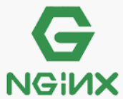









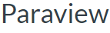

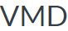



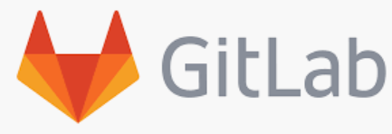
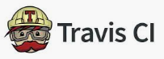
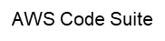
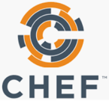


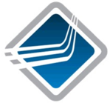

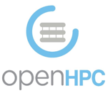
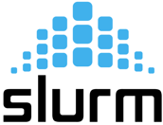

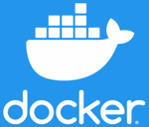
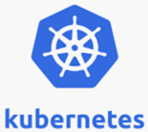


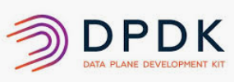

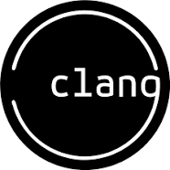

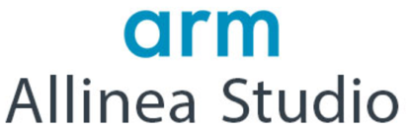
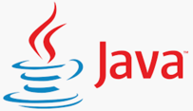

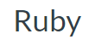
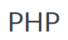
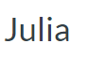
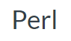

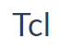
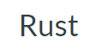
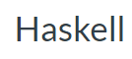

















Maturing ARM64 Computing Software Ecosystem
Numerous progress is being made daily by the ARM community to mature the ARM64 tools and improve applications performance. The ARM64 software ecosystem from applications to Linux OS is very mature right now.
Info & Forum
AIDC
https://developer.arm.com/solutions/infrastructure
https://www.huaweicloud.com/kunpeng/
https://github.com/aws/aws-graviton-gettting-started
Cloud-Native
HPC
Big Data
Cybersecurity
Automotive Computing
ADAS/AD Perception System Control
Apps
MDC
CI/CD DevTools
Jenkins
Drone IO
GitHub Actions
Middle-Ware
Languages, Compilers & Libs
C/C++, Fortran, Ada, GO
C/C++, Fortran
Node.js
C/C++
OS/FW
Linux 2
Servers/ Instances
Ecosystem Philosophy
SODA
ARM
AI for Data Infrastructure
Open Storage
Data Lakes for Big Data & AI
Notes:
The ARM64 software ecosystem is maturing rapidly:
All major Linux OS distributions with support for ARM64. Huawei has been developing and optimizing its own Linux Distribution called EulerOS for ARM64/KunPeng based on CentOS, and open sourced it as OpenEuler in March 2020 to further promote the ARM64 ecosystem.
KVM & Container support for ARM64 are also available and stable.
For programming with C/C++/Fortran, compilers and libraries are available from GNU, Clang/LLVM and ARM. The ARM Allinea Studio includes C/C++/Fortran compilers, math libraries of BLAS, LAPACK and FFTW, Debugger and Performance Profiling tools. Modern Interpreted languages such as Java, NodeJS, Python and Go are supported, and existing software written for X86 platform in these languages should run unmodified on ARM64 platform.
For Cloud-native applications, KVM virtualization, Docker container and Kubernetes are mature on ARM64; for HPC workloads, OpenMP, multiple MPI packages, Slurm job scheduler and OpenHPC are supported. Popular CI/CD tools like Jenkins, Drone IO, GitLab, GitHub Actions, Travis & CHEF are available for ARM64, as well as the AWS Code Suite for AWS Cloud clients.
Numerous cloud native open source applications have been ported and being optimized for ARM64, for example, Nginx web server, MySQL & MongoDB, Redis & Memcached, just name a few. 20% higher performance and 40% higher performance-cost effectiveness have been achieved by a lot of benchmarkings performed by the industry.
HPC is a hot area for ARM64 with 8 out of the top 10 most popular Open Source HPC applications have been ported to ARM64, and the majority is in chemistry, physics and genomics applications where double floating point operations not critical.
For big data, popular applications such as Spark, Hadoop, Kafka and Flink have been ported and optimized for ARM64. The same for the popular cybersecurity applications of Datalog, Crowdstrike, Rapid7, etc.
For the red hot emerging autonomous driving, ARM64 is emerging as a competitive solution as the control CPU in the computation-intensive perception system. AVCC is a rapid growing consortium for promoting ARM64 in ADAS and AD. The MDC-600 for L4 autonomous driving and MDC-300 for ADAS from Huawei use KunPeng 920 as the control CPU, as well as other SoC chips for AD & ADAS from Nvidia, NXP and Renesas.
For developers to get started and tune performance on ARM64 more easily, ARM, Huawei and AWS all have set up unified community web portal for document download, best practice sharing and technical support.

Slide 3















Huawei’s Strategy & Actions for Fostering ARM64 Ecosystem
ARM64/KunPeng Computing Enabler, Focus on Processor and Cloud Services, Stick to Partners First, Will not compete with partners, will invest $200M in 2020 and $400M+ in next 5 years in fostering ARM64/KunPeng Computing Ecosystem
Strategy
Investment and Actions
Huawei Cloud KunPeng Services
>$400M in 5 Years & $200M in 2020 for fostering
Focus on
KunPeng
Bare Metal
KunPeng
Elastic
KunPeng
Kubernetes Container
KunPeng
Serverless Container
10,000 Partners
1,000,000 HW/SW Engineers
Processors & Cloud
High Performance
High Throughput
High Integration
High Energy Efficiency
PC
On-Line
Industry Apps
>3000+ Industry Apps Migration done in 9 months
Motherboard
Big Data
Open
HW
SW
Servers
Middleware
Open OS
↓59% MySQL latency
Off-Line
Database
Stick to
Dependency
Porting
OS
↑30% BBS Throughput
Compiler
ACC-Lib
Perf Tuning
Partners First
↑120% TPC DS Query 70 Throughput
Open & Open Source
Not Compete w/ Partners
Lower Development Cost
KunPeng SDK Advisors
↑30% Data Management Platform Data Backup
KunPeng Community
↓30% Distributed Storage System Power Usage
Download
Documents
Tools
Service Application
Win-Win
Drivers
APP Porting Advisor
Compilers
Cloud Service Application
Computing
New Ecosystem
Commonly used
Web/MW/DB/BD
APP Perf Tuning Advisor
DevTools
Lab Resource Application
Green & Energy Saving
Secure & Reliable
Extreme Performance
Acceleration Libs
Cloud Service Advisor
Commonly used OS Images
Third-Party Resource Application
Developer Operation
Community Forum
Developer Contest
KunPeng College
Market Place
www.huaweicloud.com/kunpeng
Developer Registration
Ecosystem Philosophy
SODA
ARM
AI for Data Infrastructure
Open Storage
Data Lakes for Big Data & AI
Notes:
1. As a member of ARM64 & KunPeng Ecosystem, Huawei will adhere to philosophy of “Focus, Persistence and Win-Win” in fostering the ARM64 computing industry, and actively invest in ARM64 ecosystem construction.
2. Huawei plans to invest $200M in 2020 and over $400M in the next 5 years to foster 10,000 ARM64 partners and 1,000,000 hardware and software engineers.
3. Huawei will focus on ARM64/KunPeng processors and cloud services, strengthen strategic and long-term R & D investment, develop industry leading ARM64 processors, and provide partners with high-performance, highly integrated and efficient processors and computing power. Huawei will not compete with partners and when the proper time comes, Huawei will exit the KunPeng server business.
4. Huawei is the enabler of ARM64/KunPeng Ecosystem and adheres to the principle of “Partner-First”. Huawei has open sourced the KunPeng-920 motherboard designs and the EulerOS Linux. Huawei will give priority to partners to develop computing products based on KunPeng processors, open customers and channel resources to partners, and share market project opportunities; at the same time, Huawei provides a comprehensive tool chain and expert team to support partner application development and reduce costs through our KunPeng community web portal.
5. In the 9 months from Jan. 2019 to Oct. 2019, over 3000 industry applications were successfully ported to ARM64/KunPeng platform through the closely collaborations with our partners. Here are a few successful examples. Deepin, a Linux OS distribution company in China, achieved 59% MySQL latency reduction via their Linux OS optimization; Asiainfo, a leading software product, solution and service provider in Asia, improved their BBS system throughput by 30%, and Eisoo, an enterprise–grade file sync& sharing, data protection and managed cloud service provider in Shanghai ,also achieved 30% increase in data backup throughput with their data management platform; Xsky, an Software Defined Storage(SDS) hi-tech company in Beijing, slashed their distributed storage system power consumption by 30%. And Transwarp, a leading company in Shanghai in Big Data and Artificial Intelligence Infrastructure Software, increased their TPC DS Query 70 performance by 120%.
6. Our ultimate goal is to achieve a win-win situation with our partners. Through green, energy-saving, secure and reliable, and advanced performance of advanced computing power, we can achieve digital transformation and business innovation in all walks of life and a new era of win-win computing.

Slide 4
SODA FOUNDATION
one data framework, infinite possibilities
STEVEN TAN
SODA FOUNDATION CHAIRMAN
steven@sodafoundation.io
@stevenphtan

Slide 5
SODA for Open Autonomous Data Management
Key Messages
OpenSDS is a Linux Foundation open source project initiated by Huawei to address the challenges of storage integration in the cloud era
New data-centric trends such as machine learning and IoT created new challenges for users beyond storage
The SODA Foundation is a transformation of the OpenSDS project to address overall data challenges with a data framework to build an ecosystem for data and storage
Ecosystem Philosophy
SODA
ARM
AI for Data Infrastructure
Open Storage
Data Lakes for Big Data & AI
Notes:
Growth is accelerating due to technologies like 5G, AI, and Edge/IoT
We need to change, since the current model does not scale
Huawei will partner with the customers to deploy our leading-edge solution
One Storage, One Lake architecture and One Data feature
OpenAPIs, Open Source ecosystem support, partnerships and collaboration

Slide 6


SODA FOUNDATION
PREMIER MEMBERS
A LINUX FOUNDATION PROJECT
SODA Foundation is transformed from the OpenSDS project which focused on SDS management.
GENERAL MEMBERS
MISSION
To foster an ecosystem of open source data management and storage software for data autonomy
To offer a neutral forum for cross-projects collaboration and integration
To provide end users quality end-to-end solutions
SUPPORTERS
Ecosystem Philosophy
SODA
ARM
AI for Data Infrastructure
Open Storage
Data Lakes for Big Data & AI

Slide 7
THE SODA FRAMEWORK
SODA is an open source unified autonomous framework for data mobility from edge to core to cloud.
HIGHLIGHTS
open source - data and storage projects
standardization – data and storage management
ecosystem – hardware, software, solutions, services
certification – ecosystem components, developers, operators
Ecosystem Philosophy
SODA
ARM
AI for Data Infrastructure
Open Storage
Data Lakes for Big Data & AI

Slide 8
SODA ARCHITECTURE
SODA Core Projects - API, Dock, Controller, Multicloud, and Plugins, form the SODA framework architecture.
Key Features:
Policy-based storage provisioning with profiles
Dynamic Kubernetes persistent storage with SODA CSI driver
Integration with VMware and OpenStack
S3 multicloud data control for AWS, Azure, Google Cloud and local Ceph S3 gateway
Heterogeneous vendor storage support including OpenStack Cinder/Manila, and CSI drivers support in future
Telemetry, automation, anomaly detection, and more
Ecosystem Philosophy
SODA
ARM
AI for Data Infrastructure
Open Storage
Data Lakes for Big Data & AI

Slide 9
USE CASES
DATA MOBILITY
SODA enables seamless data tiering, replication, migration, and archiving to the cloud using a common S3 interface with multi-cloud support for AWS, Azure, Google Cloud, IBM Cloud, and other local S3 object storage such as Ceph
DATA PROTECTION
SODA uses snapshots to provide efficient data protection and instant recovery. Using data protection policies, snapshots can be programmed to be taken at intervals, and can be replicated to different storage, or to the cloud for disaster recovery
DATA LIFECYCLE
SODA combines different storage resources on-premise, and across multiple clouds to build tiers. Using data lifecycle policies, data that meets the lifecycle conditions is moved to the next tier, allowing data to be stored efficiently throughout their lifecycle
UNIFIED STORAGE
SODA abstracts multi-vendor storage and offers block, file and object storage services, monitoring, and more that work natively with Kubernetes, VMWare, and OpenStack. SODA can be easily extended to support other application frameworks.
CLOUD NATIVE STORAGE
SODA provides persistent storage to Kubernetes stateful workloads with the SODA CSI driver. SODA consolidates multi-vendor storage backends into storage pools for dynamic provisioning. We are working on allowing cloud native storage to be plugged into SODA with their CSI drivers so , reducing complex multi-driver management
DATA GOVERNANCE
SODA is working to offer a common data governance framework from edge to core to cloud to meet the needs for data regulations. This framework will provide, access control, data security, data retention, key management, etc. for data at rest and data in flight. We are looking for data governance and security experts to join us in this effort.
DATA ORCHESTRATION
SODA is working to support data orchestration for IoT, big data, machine learning and other popular application frameworks, across different backend storage, and multiple clouds with a distributed data store. We welcome developers who are interested In working on this project.
DATA ENERGY
Data energy is a new area of focus which tries to profile, analyze and optimize the energy consumption for data management. We envision data energy to be a key ROI and a competitive parameter for data solutions. SODA community has identified this for standardization to bring about energy efficient data solutions.
Ecosystem Philosophy
SODA
ARM
AI for Data Infrastructure
Open Storage
Data Lakes for Big Data & AI

Slide 10
SODA CORE STRATEGY
SODA
PROJECTS
SODA INCUBATOR: Program to help projects grow
EVENTS
SODA Forums
Conference Talks
Sponsorships
Meetups
Webinars
DEVELOPERS
SODA BOOTCAMP: Program to help developers experience, learn and contribute to projects
VENDORS
SODA FOUNDRY: Program to help vendors build and showcase SODA-based solutions in SODA Marketplace
USERS
SODA LAB: Program to help users learn, test and use SODA by developing a POC solution based on user needs
COMMUNITY
SODA AMBASSADOR: Program to empower members with resources and tools, with incentives to promote SODA
Ecosystem Philosophy
SODA
ARM
AI for Data Infrastructure
Open Storage
Data Lakes for Big Data & AI

Slide 11

SODA INCUBATOR
SODA Projects are a mix of Core, Native and Eco Projects that are serviced by the SODA Incubator program.
ECO PROJECTS
Eco Projects form the larger SODA ecosystem. They are either independent open source projects or part of other open source foundations, and are supported by the projects independent of SODA. Eco Projects integrations with other SODA projects are supported by the SODA community, and are up streamed where possible.
Member Projects
(to be incubated)
Potential Projects
NATIVE PROJECTS
Native Projects are projects donated to SODA Foundation and are either initiated by SODA members or 3rd-party organizations. Native Projects are supported by the SODA Foundation but are governed independently. They either follow the SODA release roadmap or have their own release roadmap.
Member Projects
(incubated)
Member Projects
(to be incubated)
Potential Projects
CORE PROJECTS
Core Projects are initiated by the SODA community. They form the core SODA framework, and follow the SODA release roadmap. Core Projects are governed by the TSC.
API
CONTROLLER
MULTICLOUD
TELEMETRY
DOCK
DASHBOARD
Ecosystem Philosophy
SODA
ARM
AI for Data Infrastructure
Open Storage
Data Lakes for Big Data & AI

Slide 12
RELEASES
2017H2
ZEALAND
Kubernetes FlexVolume
Vol CRUD
Standalone Cinder Integration
CSI Support
Ceph, LVM
2018H1
ARUBA
OpenStack
Replication Array-Based, Host-Based
Dashboard
Storage Profiles
Enumeration
Block Storage
Cinder Drivers
Ceph
LVM
Huawei: Dorado
2018H2
BALI
S3 Object
Multi-Cloud AWS, Azure, Ceph, Huawei
Multi-OpenStack
CSI v1.0
2019H1 CAPRI
Object Lifecycle
Telemetry
Anomaly Detection
Orchestration & Automation
File Share
NVMeoF
Multi-Cloud: GCP, IBM
Storage
Fujitsu
HPE Nimble
2019H2 DAITO
Hotpot API Refactoring, Host Management APIs, OpenAPI3.0
Added NetApp and IBM driver support (Beta)
North Bound support for VMWare & Updates for CSI
OpenSDS Multicloud and YIG integration and new features
Improved installer and documentation
2020Q1 ELBA
First SODA Release
YIG massively scalable object storage with Ceph
ACL for S3 buckets and objects
Protect data with S3 SSE
Multipart upload/download
Performance enhancements and bug fixes
Ecosystem Philosophy
SODA
ARM
AI for Data Infrastructure
Open Storage
Data Lakes for Big Data & AI

Slide 13
ROADMAP
TOWARDS DATA AUTONOMY
2020Q2
F RELEASE
SODA UNIFIED STORAGE
Storage Infrastructure Management
Block/File Multi cloud
CSI Plug & Play
LinStor integration
2020Q3
G RELEASE
SODA DATA LAKE ANALYTICS
Spark/Hadoop Streaming
NoSQL integration
S3 Select
NVMe
Data Protection
OpenEBS
2020Q4
H RELEASE
SODA EDGE DATA
SODA Edge
Search Engine
Data Lifecycle: edge to core to cloud
TensorFlow
2021Q1 I RELEASE
SODA DATA INTELLIGENCE
Data Governance
Data Protection
Data Lifecycle
2021 + J & BEYOND
SODA DATA AUTONOMY
Auto Healing
Auto Scaling
Auto Load Balancing
Auto Optimization
Auto Data Protection
Auto Data Lifecycle
Auto Data Governance
Data Exchange
Ecosystem Philosophy
SODA
ARM
AI for Data Infrastructure
Open Storage
Data Lakes for Big Data & AI

